Slide 1

West Chester Area School District
Capital Plan Update
March 2024
Wayne Birster
John Scully

Slide 2
Table of Contents
Section 1 – Student Enrollments
  Current Enrollments
  New Housing Starts
  Future Enrollment Estimates
Section 2 – Building Capacities
  Current and Anticipated
Section 3 – Capital Project List
  Cost of Projects
  Timeline
Section 4 – Debt Service
  Millage Impact

Slide 3
Section 1- Current Enrollment 2023-24

Slide 4
Section 1 – New Housing Starts Over Next 5 Years
5 Year projected increase in housing starts based on approved development plans from WCASD townships

Slide 5
Section 1 – New Housing Starts

Slide 6
Section 1 – New Housing Starts

Slide 7
Section 1 – Future Enrollment over 5 Years
– Based on Births and Approved Housing Starts

Slide 8
Section 2 – Building Capacities

Slide 9
Section 3 – Capital Project List – Cost Estimates

Slide 10
Section 3 – Capital Project List – Estimated Timeline

Slide 11
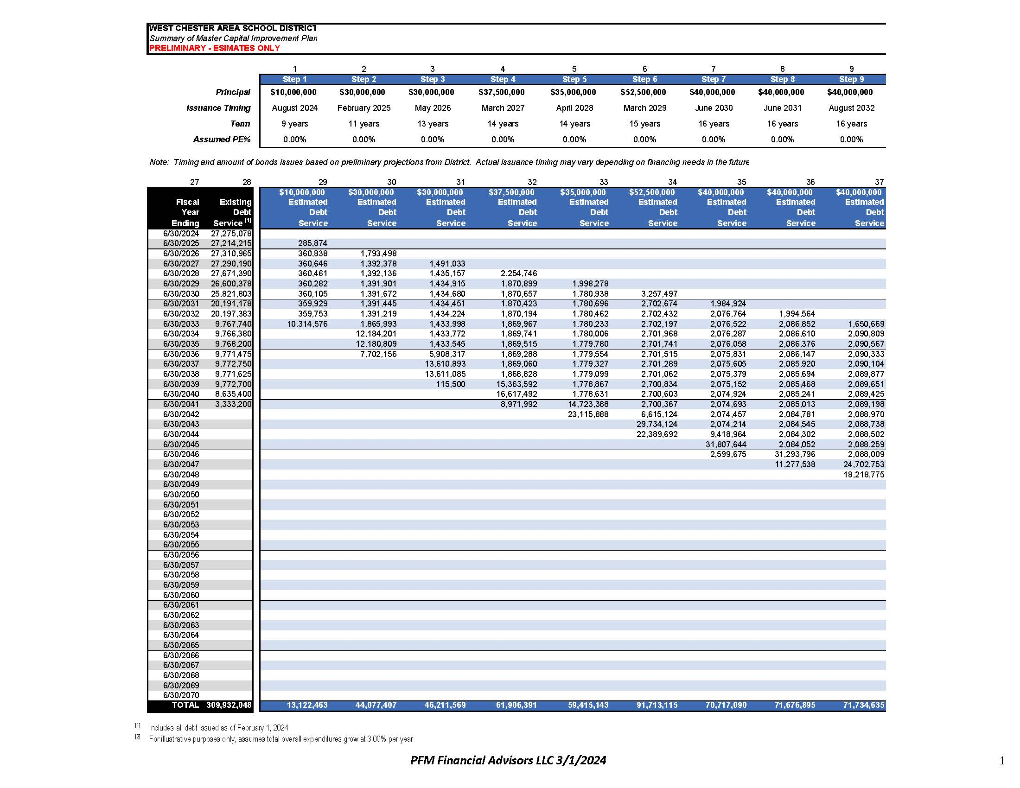
Section 4 Debt Service Estimates

Slide 12
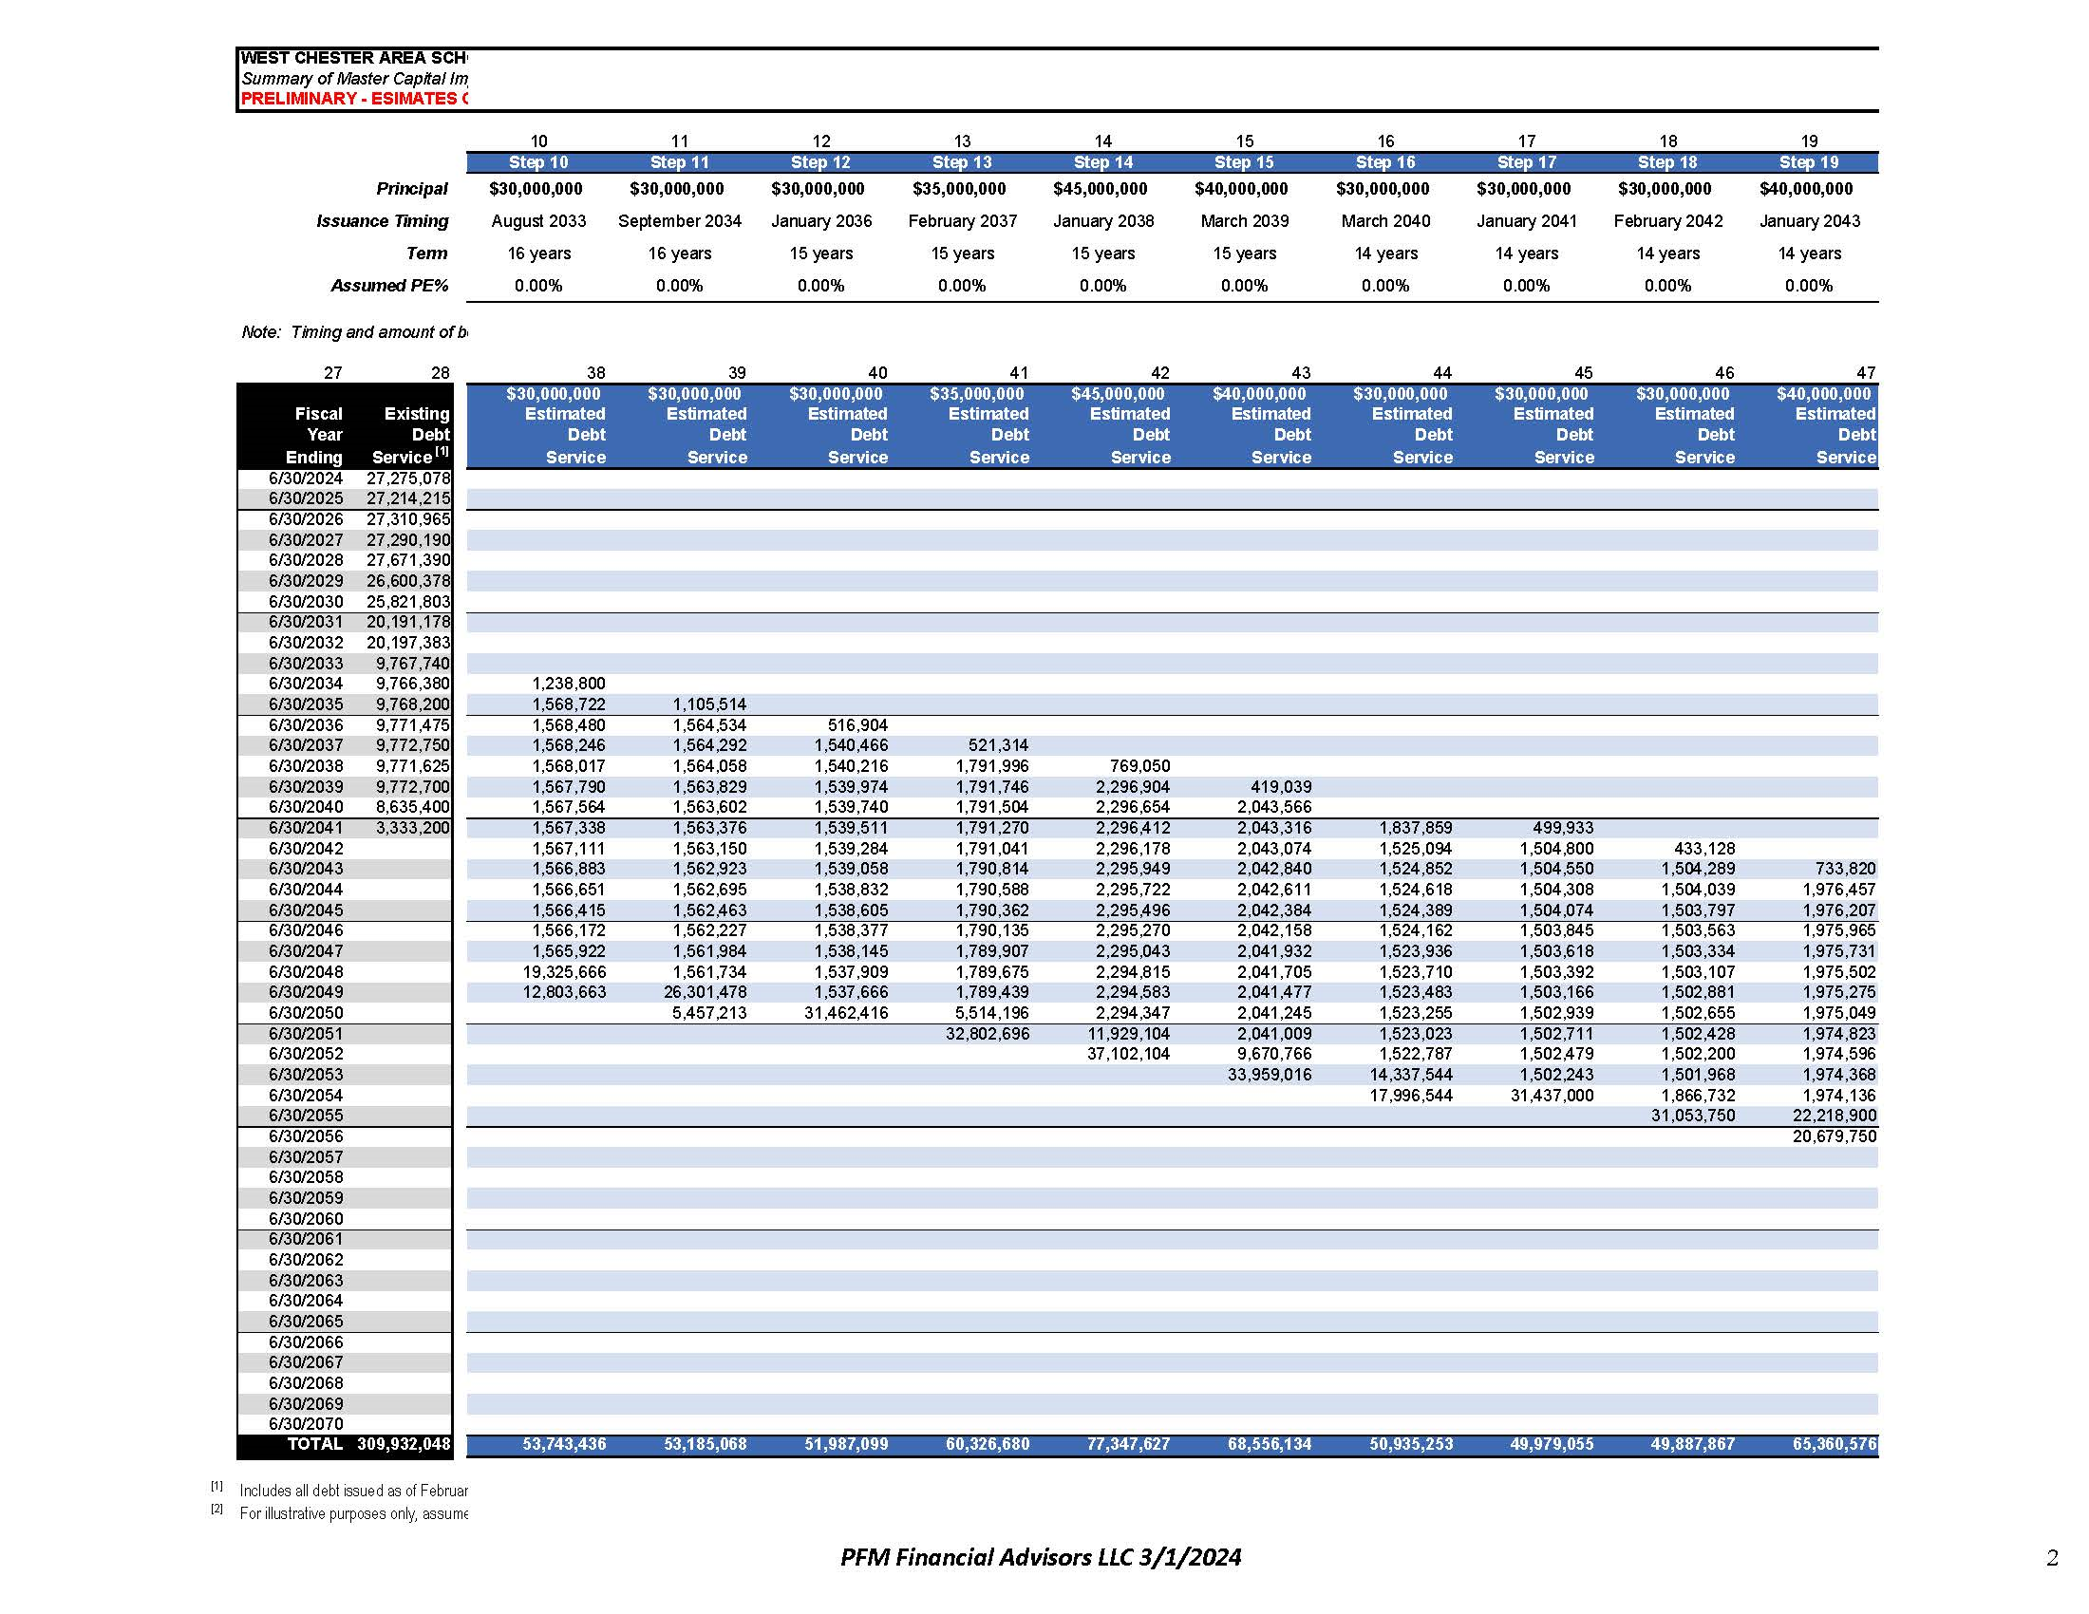
Section 4 Debt Service Estimates
Section 4 – Debt Service Estimates

Slide 13
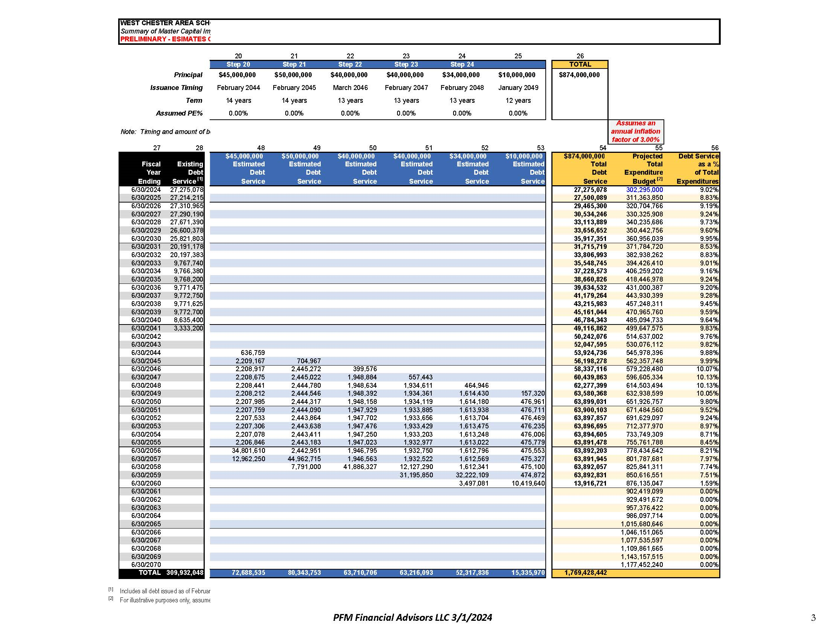
Section 4 Debt Service Estimates

Slide 14
Section 4 – Millage Analysis

